Slide 1
Capstone ETL Process Manager
Kenneth Copas

Slide 2
Functional Requirements
FR. 1&4 ETL Pipeline
Data (JSON files & API) -> MySQL
FR. 2 Command Line Interface
MySQL -> CLI
FR. 3&5 Analysis & Visualization
MySQL -> Tableau

Slide 3
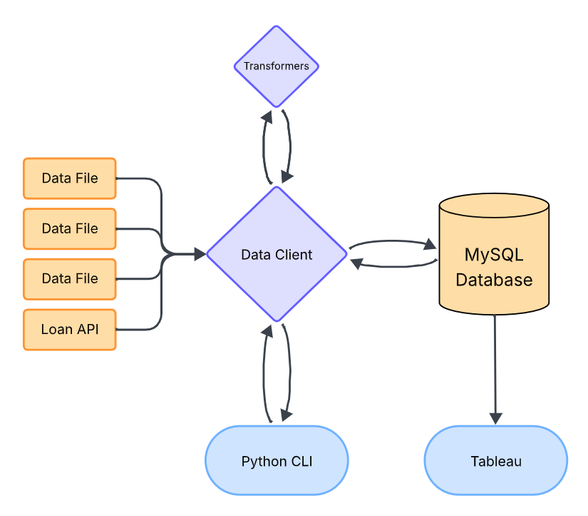
Application Workflow

Slide 4
Project Structure
main.py requirements.txt app/ ├── data_client.py # Data Client ├── menu.py # CLI Menu Class └── transformers.py # Transformer Functions config/ ├── config.json # PySpark & MySQL Configs └── constants.py # Global Constants data/ # JSON files ├── cdw_sapp_branch.json ├── cdw_sapp_credit_card.json └── cdw_sapp_customer.json | lib/ # MySQL Connector JDBC └── mysql-connector-j-9.3.0.jar sql/ # SQL Scripts ├── cli_script.sql └── init.sql utils/ ├── cli.py # CLI Builder Class └── sql.py # MySQL Connection Class docs/ ├── CAP350_Project_Specs.pdf ├── diagrams/ # Workflow Diagrams └── mapping/ # Mapping PDFs

Slide 5
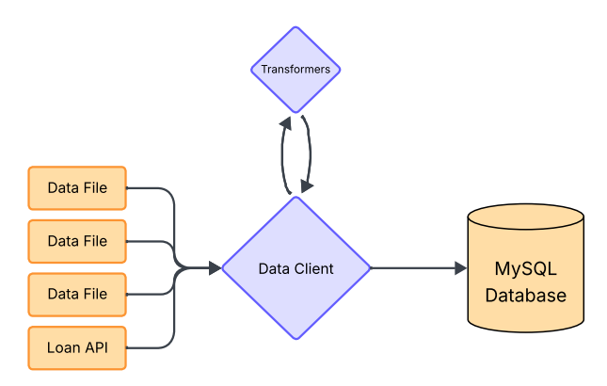
ETL Pipeline
Data Client
Manages ETL Process
Handles Database Queries
Transformers
Contains file-specific transformer functions
Handles transformer mapping

Slide 6
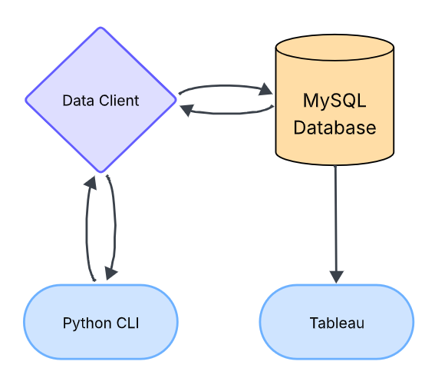
CLI & Tableau
Data Client
Cleans and loads data into MySQL for querying
Handles database query requests from CLI
Python CLI
User-friendly database interaction
Sends database queries to Data Client
Tableau
Data Analysis & Visualization
Sources data from MySQL database

Slide 7
Data Client - SQL Scripts
init.sql Database Initialization Initializes database and tables Tests for existing data in the database | cli_scripts.sql CLI Queries Contains multiple queries that each correspond to a CLI query option Queries are parameterized and separated by a query-id and delimiter

